Slide 1
CMSC 691 Malware Analysis
Lecture 16
Data Encoding

Slide 2
Data Encoding
Malware frequently encodes data:
Embedded executables
Encoding strings to hide from static analysis
Encrypting network traffic
Malware authors may use different encoding styles to best suit their needs
Simple ciphers/encoding routines
Sophisticated cryptography

Slide 3
Simple Ciphers

Slide 4
Simple Ciphers
Encoding may not need to be sophisticated
Just enough to disguise content from basic static analysis
Advantages of using simple ciphers:
Small and less obvious than more complex encryption
Low overhead, fast runtime

Slide 5
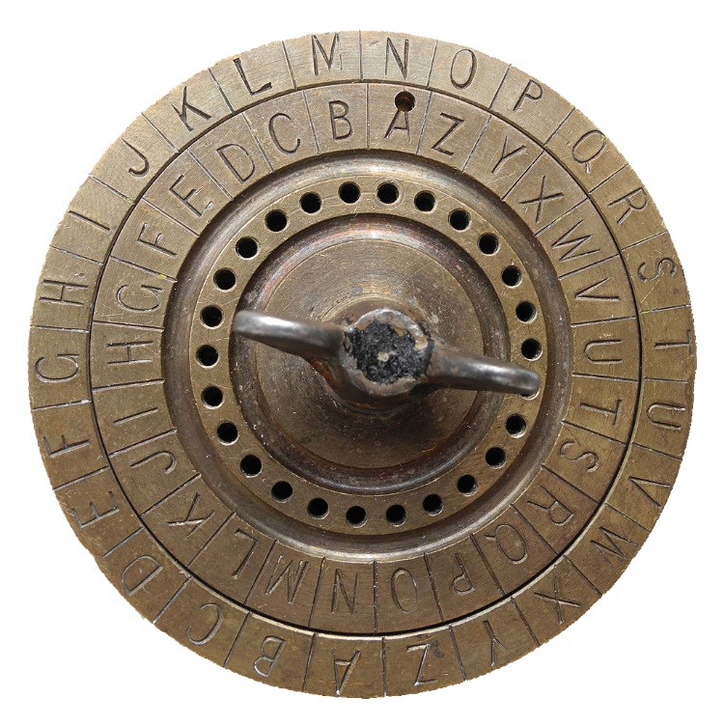
Caesar Cipher
Famous historical cipher used by Julius Caesar
Key is “rotation” of the alphabet
Caesar always used it with a shift of 3
Only 26 possible keys
Trivial to brute force
“Dogs are great” 🡪 k = 7 🡪 “Kvnz hyl nylha”

Slide 6
XOR Cipher

Slide 7
XOR Encryption Example
m k c
0 | 1 | 0 | 1 | 0 | 1 | 0 | 1 | 0 | 1 | 0 | 0 | 1 | 1 | 0 | 1 | 0 | 1 | 0 | 0 | 0 | 0 | 1 | 0 | 0 | 1 | 0 | 0 | 0 | 0 | 1 | 1
0 | 1 | 1 | 1 | 1 | 0 | 0 | 0 | 1 | 0 | 1 | 0 | 0 | 1 | 1 | 0 | 0 | 0 | 0 | 1 | 1 | 1 | 1 | 1 | 0 | 0 | 0 | 0 | 0 | 0 | 1 | 1
0 | 0 | 1 | 0 | 1 | 1 | 0 | 1 | 1 | 1 | 1 | 0 | 1 | 0 | 1 | 1 | 0 | 1 | 0 | 1 | 1 | 1 | 0 | 1 | 0 | 1 | 0 | 0 | 0 | 0 | 0 | 0

Slide 8
XOR Decryption Example
Now let’s decrypt!
Converting back to hex -> 0x 55 4D 42 43
And finally back to ASCII -> UMBC
c k m
0 | 0 | 1 | 0 | 1 | 1 | 0 | 1 | 1 | 1 | 1 | 0 | 1 | 0 | 1 | 1 | 0 | 1 | 0 | 1 | 1 | 1 | 0 | 1 | 0 | 1 | 0 | 0 | 0 | 0 | 0 | 0
0 | 1 | 1 | 1 | 1 | 0 | 0 | 0 | 1 | 0 | 1 | 0 | 0 | 1 | 1 | 0 | 0 | 0 | 0 | 1 | 1 | 1 | 1 | 1 | 0 | 0 | 0 | 0 | 0 | 0 | 1 | 1
0 | 1 | 0 | 1 | 0 | 1 | 0 | 1 | 0 | 1 | 0 | 0 | 1 | 1 | 0 | 1 | 0 | 1 | 0 | 0 | 0 | 0 | 1 | 0 | 0 | 1 | 0 | 0 | 0 | 0 | 1 | 1

Slide 9
Identifying XOR Loops in IDA Pro
XOR ciphers are typically written as a tight loop containing an XOR instruction
Remember that XOR is most often used to zero a register
XOR EAX, EAX
So we want to search for loops containing:
XOR between a register/memory with a constant
XOR between a register/memory with another register

Slide 10
ROL and ROT
Rotate the bits within a byte to the left or right
Encrypt with one and decrypt with the other

Slide 11
Base64 Encoding
Encoding for representing raw bytes as ascii-printable characters
Uses 64 characters: a-z, A-Z, 0-9, +, and /
Padding at the end represented by =
Malware sometimes uses custom base64 alphabets/orderings

Slide 12
Base64 Encoding
From PMA Chap. 13

Slide 13
Review: FLOSS and XORStrings
FLOSS can print some types of encoded strings!
Stack strings
Some simple ciphers
floss -n 8 --no-decoded-strings [file path] | less
XORStrings can find XOR and ROL/ROT encoded strings

Slide 14
CyberChef Demo

Slide 15
Basic Encoding Demo
PMA Lab 13-1

